Slide 1
Planning a Software Project

Slide 2
Agenda
Background
Process planning
Effort estimation
Schedule and resource estimation
Quality Planning
Risk management
Configuration Management
Project monitoring plans
Jalote - Project Planning

Slide 3
Software Project
Goal: Build a software system to meet commitments on cost, schedule, quality
Worldwide - many projects fail
  one-third are runaways with cost or schedule overrun of more than 125%
Jalote - Project Planning

Slide 4
Project Failures
Major reasons for project runaways
  unclear objectives
  bad planning
  no project management methodology
  new technology
  insufficient staff
All of these relate to project management
Effective project management is key to successfully executing a project
Jalote - Project Planning

Slide 5
Why improve PM?
Better predictability leading to commitments that can be met
Lower cost through reduced rework, better resource mgmt, better planning,..
Improved quality through proper quality planning and control
Better control through change control, CM, monitoring etc.
Jalote - Project Planning

Slide 6
Why improve PM ….
Better visibility into project health and state leading to timely intervention
Better handling of risks reducing the chances of failure
All this leads to higher customer satisfaction
And self and organization improvement
Jalote - Project Planning

Slide 7
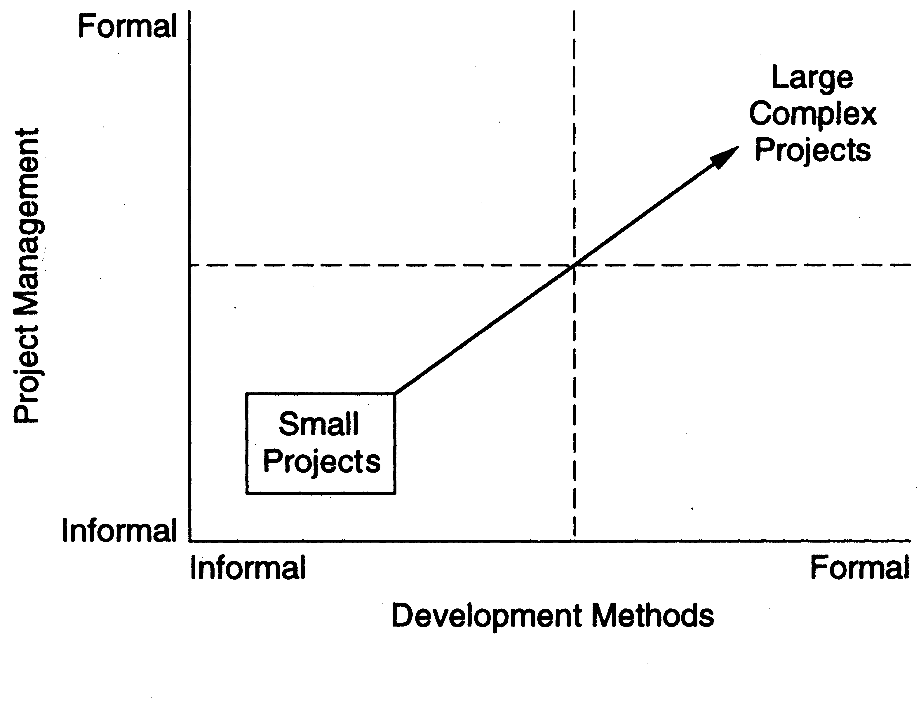
Two Dimensions in project execution
Jalote - Project Planning

Slide 8
Process-based Project Execution
Small project both engg and PM can be done informally
Large projects require formality
Formality: well defined processes used for each task; measurements used to control
Here we focus on processes for PM only
Jalote - Project Planning

Slide 9
The Project Mgmt Process
Has three phases - planning, monitoring and control, and closure
Planning is done before the main engineering LC and closure after the LC
Monitoring phase is in parallel with LC
Jalote - Project Planning

Slide 10
Project Planning
Basic objective: To create a plan to meet the commitments of the project, I.e. create a path that, if followed, will lead to a successful project
Planning involves defining the LC process to be followed, estimates, detailed schedule, plan for quality, etc.
Main output - a project management plan and the project schedule
Jalote - Project Planning

Slide 11
Key Planning Tasks
Define suitable processes for executing the project
Estimate effort
Define project milestones and create a schedule
Define quality objectives and a quality plan
Identify risks and make plans to mitigate them
Define measurement plan, project-tracking procedures, training plan, team organization, etc.
Jalote - Project Planning

Slide 12
Process Planning
Plan how the project will be executed, I.e. the process to be followed
Process will decide the tasks, their ordering, milestones
Hence process planning is an important project planning task
Should plan for LC and PM processes as well as supporting processes
Jalote - Project Planning

Slide 13
Life Cycle Process
Various LC models - waterfall, iterative, prototyping; diff models suit different projects
During planning can select the model that is best for the project
This gives the overall process which has to be fine-tuned to suit the project needs
Usually done by process tailoring - changing the process to suit the project
Tailoring finally results in adding, deleting, modifying some process steps
Jalote - Project Planning

Slide 14
Effort Estimation

Slide 15
Effort Estimation
For a project total cost and duration has to be committed in start
Requires effort estimation, often in terms of person-months
Effort estimate is key to planning - schedule, cost, resources depend on it
Many problems in project execution stem from improper estimation
Jalote - Project Planning

Slide 16
Estimation..
No easy way, no silver bullet
Estimation accuracy can improve with more information about the project
Early estimates are more likely to be inaccurate than later
  More uncertainties in the start
  With more info, estimation becomes easier
Jalote - Project Planning

Slide 17
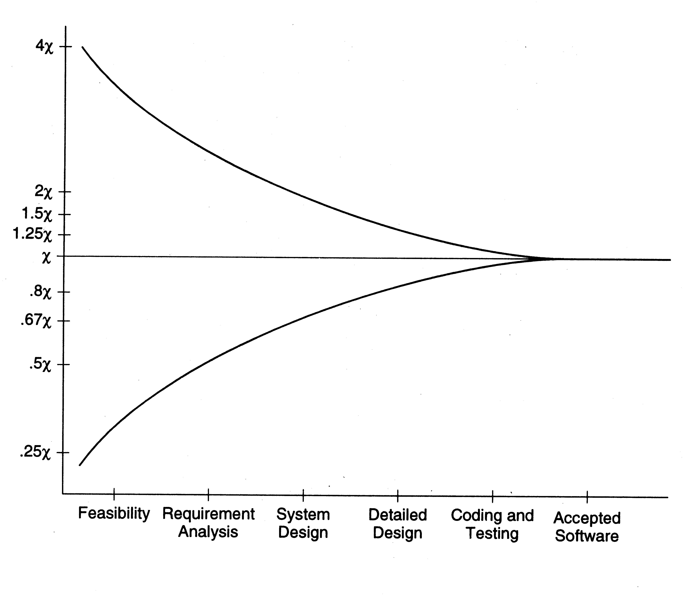
Estimation accuracy
Jalote - Project Planning

Slide 18
Effort Estimation Models..
A model tries to determine the effort estimate from some parameter values
A model also requires input about the project, and cannot work in vacuum
So to apply a model, we should be able to extract properties about the system
Two types of models - top-down and bottom-up
Jalote - Project Planning

Slide 19
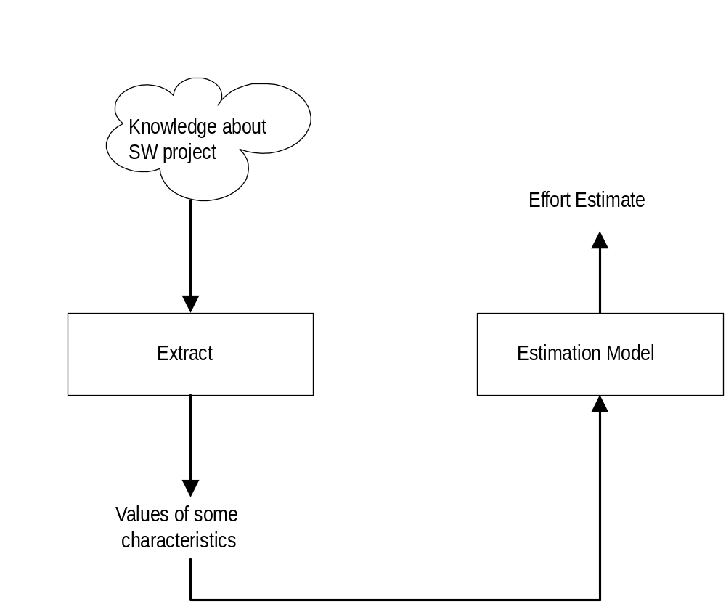
Effort Estimation Models
Jalote - Project Planning

Slide 20
Top-down Estimation
First determines the total effort, then effort for components
Usually works with overall size
One method is to see estimate as a function of effort; the common function used is
Effort = a * size ^{b}
E is in person-months, size in KLOC
Constants a and b determined through regression analysis of past project data
Jalote - Project Planning

Slide 21
Top down estimation
Can also estimate from size and productivity
  Get the estimate of the total size of the software
  Estimate project productivity using past data and project characteristics
  Obtain the overall effort estimate from productivity and size estimates
Effort distribution data from similar project are used to estimate effort for different phases
Jalote - Project Planning

Slide 22
Bottom-up Estimation
Effort for components and phases first estimated, then the total
Can use activity based costing - all activities enumerated and then each activity estimated separately
Can group activities into classes - their effort estimate from past data
Jalote - Project Planning

Slide 23
An Estimation Procedure
Identify programs in the system and classify them as simple, medium, or complex (S/M/C)
Define the average coding effort for S/M/C
Get the total coding effort.
Use the effort distribution in similar projects to estimate effort for other tasks and total
Refine the estimates based on project specific factors
Jalote - Project Planning

Slide 24
COCOMO Model for Estimation
Is a top-down approach
Uses size, but adjusts using some factors
Basic procedure
  Obtain initial estimate using size
  Determine a set of 15 multiplying factors from different project attributes
  Adjust the effort estimate by scaling it with the final multiplying factor
Jalote - Project Planning

Slide 25
COCOMO..
Initial estimate: a * size ^{b} ; some standard values for a, b given for diff project types
There are 15 cost driver attributes line reliability, complexity, application experience, capability, …
Each factor is rated, and for the rating a multiplication factor is given
Final effort adjustment factor is the product of the factors for all 15 attributes
Jalote - Project Planning

Slide 26
COCOMO – Some cost drivers
Cost Driver | Very low | Low | Nominal | High | Very High
Required reliability Database size Product complexity Execution time constraint Memory constraint Analyst capability Application experience Programmer capability Use of software tools Development schedule | .75 .7 1.46 1.29 1.42 1.24 1.23 | .88 .94 .85 1.19 1.13 1.17 1.10 1.08 | 1.0 1.0 1.0 1.0 1.0 1.0 1.0 1.0 1.0 1.0 | 1.15 1.08 1.15 1.11 1.06 .86 .91 .86 .91 1.04 | 1.4 1.16 1.3 1.3 1.21 .71 .82 .70 .83 1.1
Jalote - Project Planning

Slide 27
COCOMO – effort distribution
Effort distribution among different phases is given as a percent of effort
Eg. For medium size product it is
  Product design – 16%
  Detailed design – 24%
  Coding and UT – 38%
  Integration and test – 22%
Jalote - Project Planning

Slide 28
Scheduling and Staffing

Slide 29
Project Schedule
A project Schedule is at two levels - overall schedule and detailed schedule
Overall schedule comprises of major milestones and final date
Detailed schedule is the assignment of lowest level tasks to resources
Jalote - Project Planning

Slide 30
Overall Schedule
Depends heavily on the effort estimate
For an effort estimate, some flexibility exists depending on resources assigned
Eg a 56 PM project can be done in 8 months (7 people) or 7 months (8 people)
Stretching a schedule is easy; compressing is hard and expensive
Jalote - Project Planning

Slide 31
Overall Scheduling...
One method is to estimate schedule S (in months) as a function of effort in PMs
Can determine the fn through analysis of past data; the function is non linear
COCOMO: S = 2.5 E ^{3.8}
Often this schedule is checked and corrected for the specific project
One checking method – square root check
Jalote - Project Planning

Slide 32
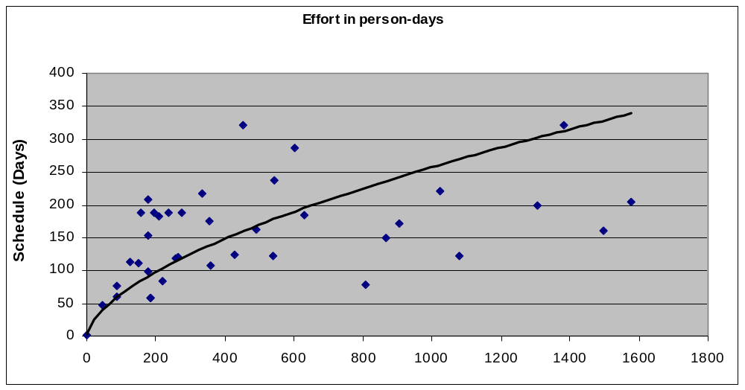
Determining Overall Schedule from past data
Jalote - Project Planning

Slide 33
Determining Milestones
With effort and overall schedule decided, avg project resources are fixed
Manpower ramp-up in a project decides the milestones
Manpower ramp-up in a project follows a Rayleigh curve - like a normal curve
In reality manpower build-up is a step function
Jalote - Project Planning

Slide 34
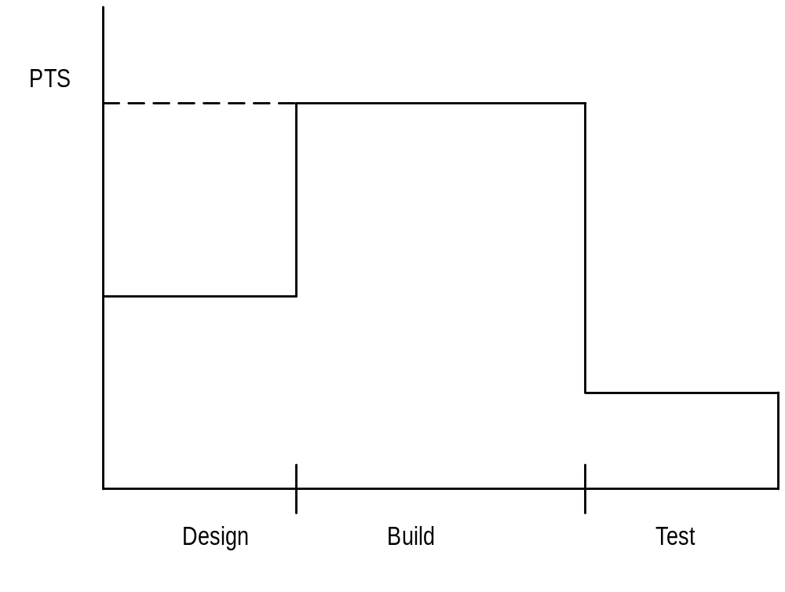
Manpower Ramp-up
Jalote - Project Planning

Slide 35
Milestones ...
With manpower ramp-up and effort distribution, milestones can be decided
Effort distribution and schedule distribution in phases are different
Generally, the build has larger effort but not correspondingly large schedule
COCOMO specifies distr of overall sched. Design – 19%, programming – 62%, integration – 18%
Jalote - Project Planning

Slide 36
An Example Schedule
# | Task | Dur. (days) | Work (p-days) | Start Date | End Date
2 | Project Init tasks | 33 | 24 | 5/4 | 6/23
74 | Training | 95 | 49 | 5/8 | 9/29
104 | Knowledge sharing | 78 | 20 | 6/2 | 9/30
114 | Elaboration iteration I | 55 | 55 | 5/15 | 6/23
198 | Construction iteration I | 9 | 35 | 7/10 | 7/21
Jalote - Project Planning

Slide 37
Detailed Scheduling
To reach a milestone, many tasks have to be performed
Lowest level tasks - those that can be done by a person (in less than 2-3 days)
Scheduling - decide the tasks, assign them while preserving high-level schedule
Is an iterative task - if cannot “fit” all tasks, must revisit high level schedule
Jalote - Project Planning

Slide 38
Detailed Scheduling
Detailed schedule not done completely in the start - it evolves
Can use MS Project for keeping it
Detailed Schedule is the most live document for managing the project
Any activity to be done must get reflected in the detailed schedule
Jalote - Project Planning

Slide 39
An example task in detail schedule
Module | Act Code | Task | Duration | Effort
History | PUT | Unit test # 17 | 1 day | 7 hrs
St. date | End date | %comp | Depend. | Resource
7/18 | 7/18 | 0% | Nil | SB
Jalote - Project Planning

Slide 40
Detail schedule
Each task has name, date, duration, resource etc assigned
% done is for tracking (tools use it)
The detailed schedule has to be consistent with milestones
  Tasks are sub-activities of milestone level activities, so effort should add up, total schedule should be preserved
Jalote - Project Planning

Slide 41
Team Structure
To assign tasks in detailed schedule, need to have a clear team structure
Hierarchic team org is most common
  Project manager has overall responsibility; also does design etc.
  Has programmers and testers for executing detailed tasks
  May have config controller, db manager, etc
Jalote - Project Planning

Slide 42
Team structure..
An alternative – democratic teams
  Can work for small teams; leadership rotates
Another one used for products
  A dev team led by a dev mgr, a test team led by test mgr, and a prog. Mgmt team
  All three report to a product mgr
  Allows specialization of tasks and separate career ladders for devs, tests, PMs
Jalote - Project Planning

Slide 43
SCM process and planning
Have discussed SCM process earlier
During planning, the SCM activities are planned along with who will perform them
Have discussed planning also earlier
  Includes defining CM items, naming scheme, directory structure, access restrictions, change control, versioning, release procedure etc
Jalote - Project Planning

Slide 44
Quality Planning

Slide 45
Quality Planning
Delivering high quality is a basic goal
Quality can be defined in many ways
Current industry standard - delivered defect density (e.g. #defects/KLOC)
Defect - something that causes software to behave in an inconsistent manner
Aim of a project - deliver software with low delivered defect density
Jalote - Project Planning

Slide 46
Defect Injection and Removal
Software development is labor intensive
Defects are injected at any stage
As quality goal is low delivered defect density, these defects have to be removed
Done primarily by quality control (QC) activities of reviews and testing
Jalote - Project Planning

Slide 47
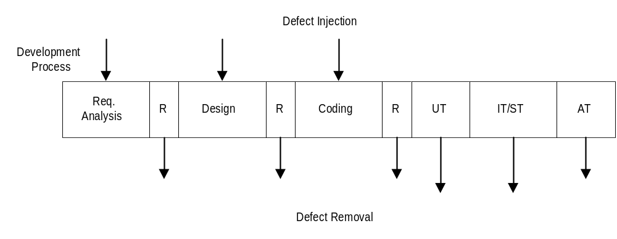
Defect Injection and Removal
Jalote - Project Planning

Slide 48
Approaches to Quality Management
Ad hoc - some testing, some reviews done as and when needed
Procedural - defined procedures are followed in a project
Quantitative - defect data analysis done to manage the quality process
Jalote - Project Planning

Slide 49
Procedural Approach
A quality plan defines what QC tasks will be undertaken and when
Main QC tasks - reviews and testing
Guidelines and procedures for reviews and testing are provided
During project execution, adherence to the plan and procedures ensured
Jalote - Project Planning

Slide 50
Quantitative Approach
Goes beyond asking “has the procedure been executed”
Analyzes defect data to make judgements about quality
Past data is very important
Key parameters - defect injection and removal rates, defect removal efficiency (DRE)
Jalote - Project Planning

Slide 51
Quality Plan
The quality plan drives the quality activities in the project
Level of plan depends on models available
Must define QC tasks that have to be performed in the project
Can specify defect levels for each QC tasks (if models and data available)
Jalote - Project Planning

Slide 52
Risk Management

Slide 53
Risk Management
Any project can fail - reasons can be technical, managerial, etc.
Project management aims to tackle the project management aspect
Engineering life cycles aim to tackle the engineering issues
A project may fail due to unforeseen events - risk management aims to tackle this
Jalote - Project Planning

Slide 54
Risk Management
Risk: any condition or event whose occurrence is not certain but which can cause the project to fail
Aim of risk management: minimize the effect of risks on a project
Jalote - Project Planning

Slide 55
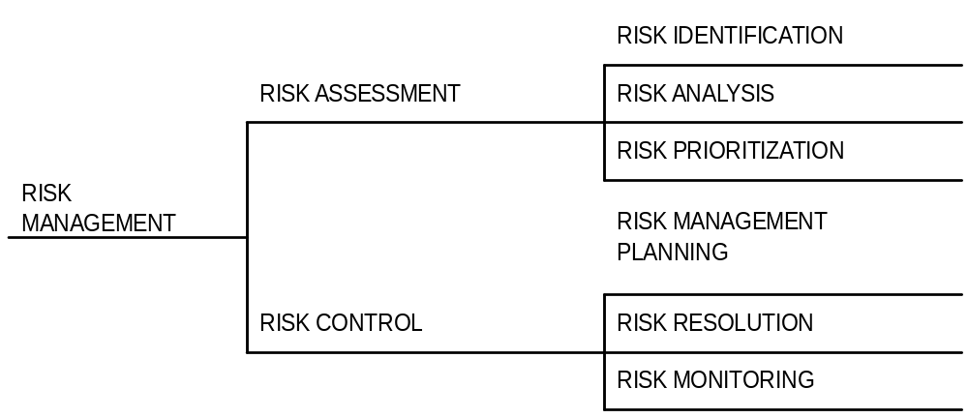
Risk Management Tasks
Jalote - Project Planning

Slide 56
Risk Identification
To identify possible risks to a project, i.e. to those events that might occur and which might cause the project to fail
No “algorithm” possible, done by “what ifs”, checklists, past experience
Can have a list of “top 10” risks that projects have seen in past
Jalote - Project Planning

Slide 57
Top Risk Examples
Shortage of technically trained manpower
Too many requirement changes
Unclear requirements
Not meeting performance requirements
Unrealistic schedules
Insufficient business knowledge
Working on new technology
Jalote - Project Planning

Slide 58
Risk Prioritization
The number of risks might be large
Must prioritize them to focus attention on the “high risk” areas
For prioritization, impact of each risk must be understood
In addition, probability of the risk occurring should also be understood
Jalote - Project Planning

Slide 59
Risk Prioritization ...
Risk exposure (RE) = probability of risk occurring * risk impact
RE is the expected value of loss for a risk
Prioritization can be done based on risk exposure value
Plans can be made to handle high RE risks
Jalote - Project Planning

Slide 60
A Simple approach to Risk Prioritization
Classify risk occurrence probabilities as: Low, Medium, High
Classify risk impact as: Low, Medium, High
Identify those that are HH, or HM/MH
Focus on these for risk mitigation
Will work for most small and medium sized projects
Jalote - Project Planning

Slide 61
Risk Control
Can the risk be avoided?
  E.g. if new hardware is a risk, it can be avoided by working with proven hardware
For others, risk mitigation steps need to be planned and executed
  Actions taken in the project such that if the risk materializes, its impact is minimal
  Involves extra cost
Jalote - Project Planning

Slide 62
Risk Mitigation Examples
Too many requirement changes
  Convince client that changes in requirements will have an impact on the schedule
  Define a procedure for requirement changes
  Maintain cumulative impact of changes and make it visible to client
  Negotiate payment on actual effort.
Jalote - Project Planning

Slide 63
Examples ...
Manpower attrition
  Ensure that multiple resources are assigned on key project areas
  Have team building sessions
  Rotate jobs among team members
  Keep backup resources in the project
  Maintain documentation of individual’s work
  Follow the CM process and guidelines strictly
Jalote - Project Planning

Slide 64
Examples ...
Unrealistic schedules
  Negotiate for better schedule
  Identify parallel tasks
  Have resources ready early
  Identify areas that can be automated
  If the critical path is not within the schedule, negotiate with the client
  Negotiate payment on actual effort
Jalote - Project Planning

Slide 65
Risk Mitigation Plan
Risk mitigation involves steps that are to be performed (hence has extra cost)
It is not a paper plan - these steps should be scheduled and executed
These are different from the steps one would take if the risk materializes - they are performed only if needed
Risks must be revisited periodically
Jalote - Project Planning

Slide 66
Project Monitoring Plans

Slide 67
Background
A plan is a mere document that can guide
It must be executed
To ensure execution goes as per plan, it must be monitored and controlled
Monitoring requires measurements
And methods for interpreting them
Monitoring plan has to plan for all the tasks related to monitoring
Jalote - Project Planning

Slide 68
Measurements
Must plan for measurements in a project
Without planning, measurements will not be done
Main measurements – effort, size, schedule, and defects
  Effort – as this is the main resource; often tracked through effort reporting tools
  Defects – as they determine quality; often defect logging and tracking systems used
During planning – what will be measured, how, tool support, and data management
Jalote - Project Planning

Slide 69
Project Tracking
Goal: To get visibility in project execution so corrective actions can be taken when needed to ensure project succeeds
Diff types of monitoring done at projects; measurements provide data for it
Jalote - Project Planning

Slide 70
Tracking…
Activity-level monitoring
  Each activity in detailed schd is getting done
  Often done daily by managers
  A task done marked 100%; tools can determine status of higher level tasks
Status reports
  Generally done weekly to take stock
  Summary of activities completed, pending
  Issues to be resolved
Jalote - Project Planning

Slide 71
Tracking…
Milestone analysis
  A bigger review at milestones
  Actual vs estimated for effort and sched is done
  Risks are revisited
  Changes to product and their impact may be analyzed
Cost-schedule milestone graph is another way of doing this
Jalote - Project Planning

Slide 72
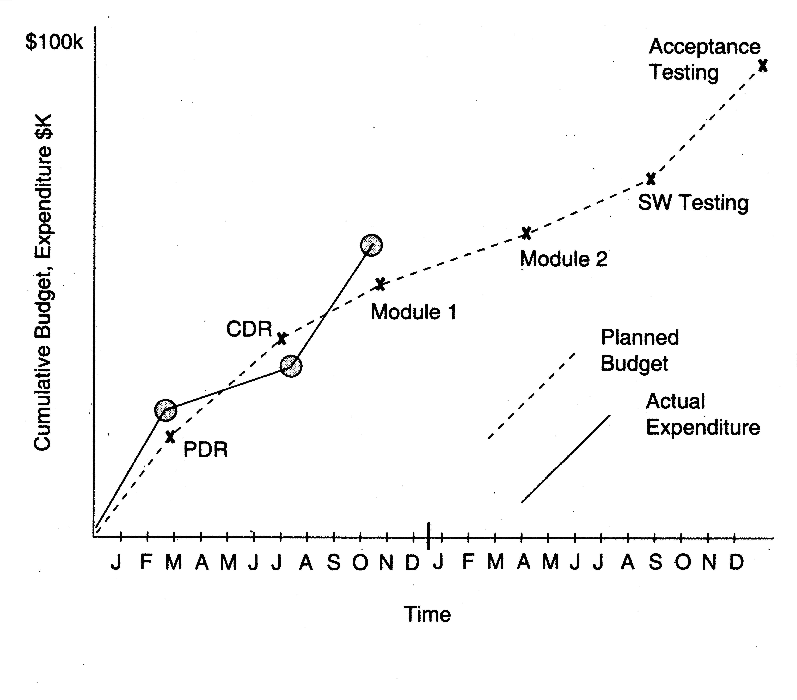
Cost-schedule milestone graph
Jalote - Project Planning

Slide 73
Project Management Plan
The project management plan (PMP) contains outcome of all planning activities - focuses on overall project management
Besides PMP, a project schedule is needed
  Reflects what activities get done in the project
  Microsoft project (MSP) can be used for this
  Based on project planning; is essential for day-to-day management
  Does not replace PMP !
Jalote - Project Planning

Slide 74
PMP Structure - Example
Project overview - customer, start and end date, overall effort, overall value, main contact persons, project milestones, development environment..
Project planning - process and tailoring, requirements change mgmt, effort estimation, quality goals and plan, risk management plan, ..
Jalote - Project Planning

Slide 75
PMP Example ...
Project tracking - data collection, analysis frequency, escalation procedures, status reporting, customer complaints, …
Project team, its organization, roles and responsibility, …
Jalote - Project Planning

Slide 76
Project Planning - Summary
Project planning forms the foundation of project management
Key aspects: effort and schedule estimation, quality planning, risk mgmt., …
Outputs of all can be documented in a PMP, which carries all relevant info about project
Besides PMP, a detailed project schedule maintains tasks to be done in the project
Jalote - Project Planning

Slide 77
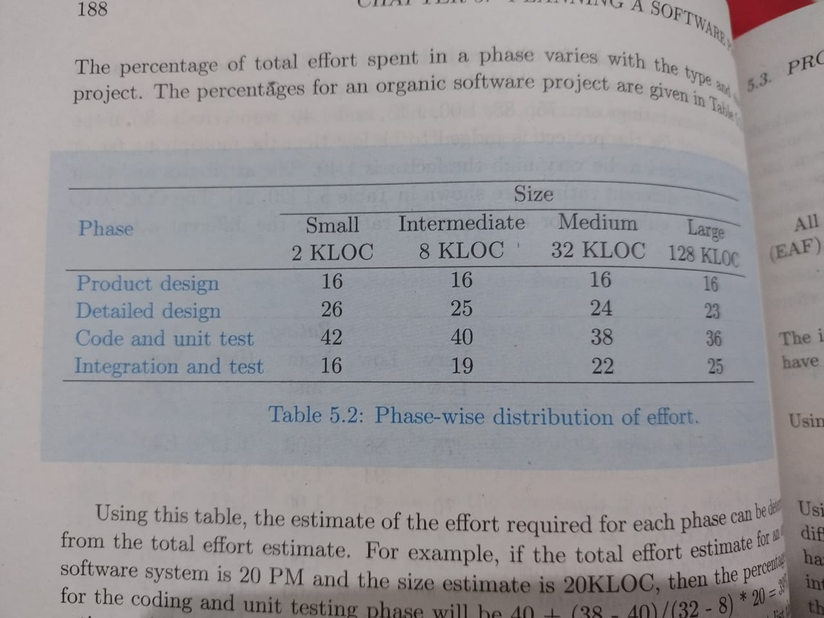
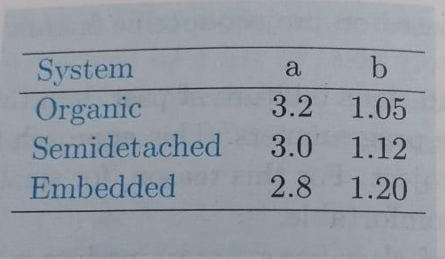
Example
Jalote - Project Planning

Slide 78
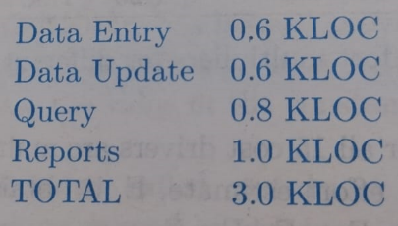
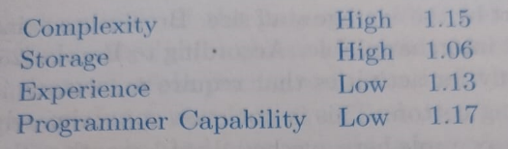
Jalote - Project Planning

Slide 79



Jalote - Project Planning

Slide 80
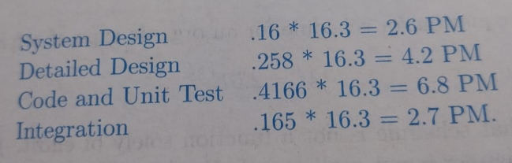
Jalote - Project Planning

